Slide 1
Language Tutor
Diploma In Computer Engineering
Notes:
Title Page

Slide 2
Team Members
G.Gnaneshwar : 13047-CM-052
Mohd. Arshaque : 13047-CM-027
D.Nikhil Duth : 13047-CM-038
M.Sudhir Kumar : 13047-CM-040
D.Shiva Kumar : 13047-CM-041
Srikanth : 13047-CM-049
Aziz : 13047-CM-035

Slide 3
Abstract
Day-by-day, importance of computer programming language is increasing. There are people who cannot attend the coaching centers due to distance, money, time, etc. So, we are providing Language Tutor, a platform for learning programming languages through online.

Slide 4
Introduction
Our intension is to give an helping hand to those who are interested to learn Computer Languages like C-language, HTML, C++, CSS, Java, etc..
We provide C-language in our tutor.
Our project is to provide a website which deals with tutorial through which a user/learner can learn languages. When they get any doubts, they can spontaneously clarify by visiting our website.

Slide 5
Advantages
Can develop their computer language skills.
Can save their time and money.

Slide 6
System Requirements
Hardware Requirements:
Processor - Pentium-III
Speed - 2.0GHz
RAM - 1 GB
Software Requirements:
Operating System : Windows XP/7/8/8.1/10
Application : Google Chrome, Mozilla Firefox
Front End : HTML, CSS
Plug-in languages : JavaScript
Database Connectivity : MySQL

Slide 7
Modules
In our project criteria, deals with following modules:
Admin Login
User Login
C-Language

Slide 8
Contents
As on the part of project, we are creating a website which contains the below contents.
History of languages
Basics of Language
Main Topics
Syntax’s
Example programs
Important programs

Slide 9
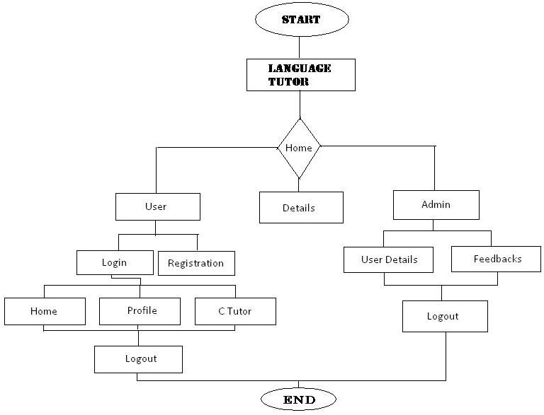
Flow Chart

Slide 10
Thank You

